Slide 1
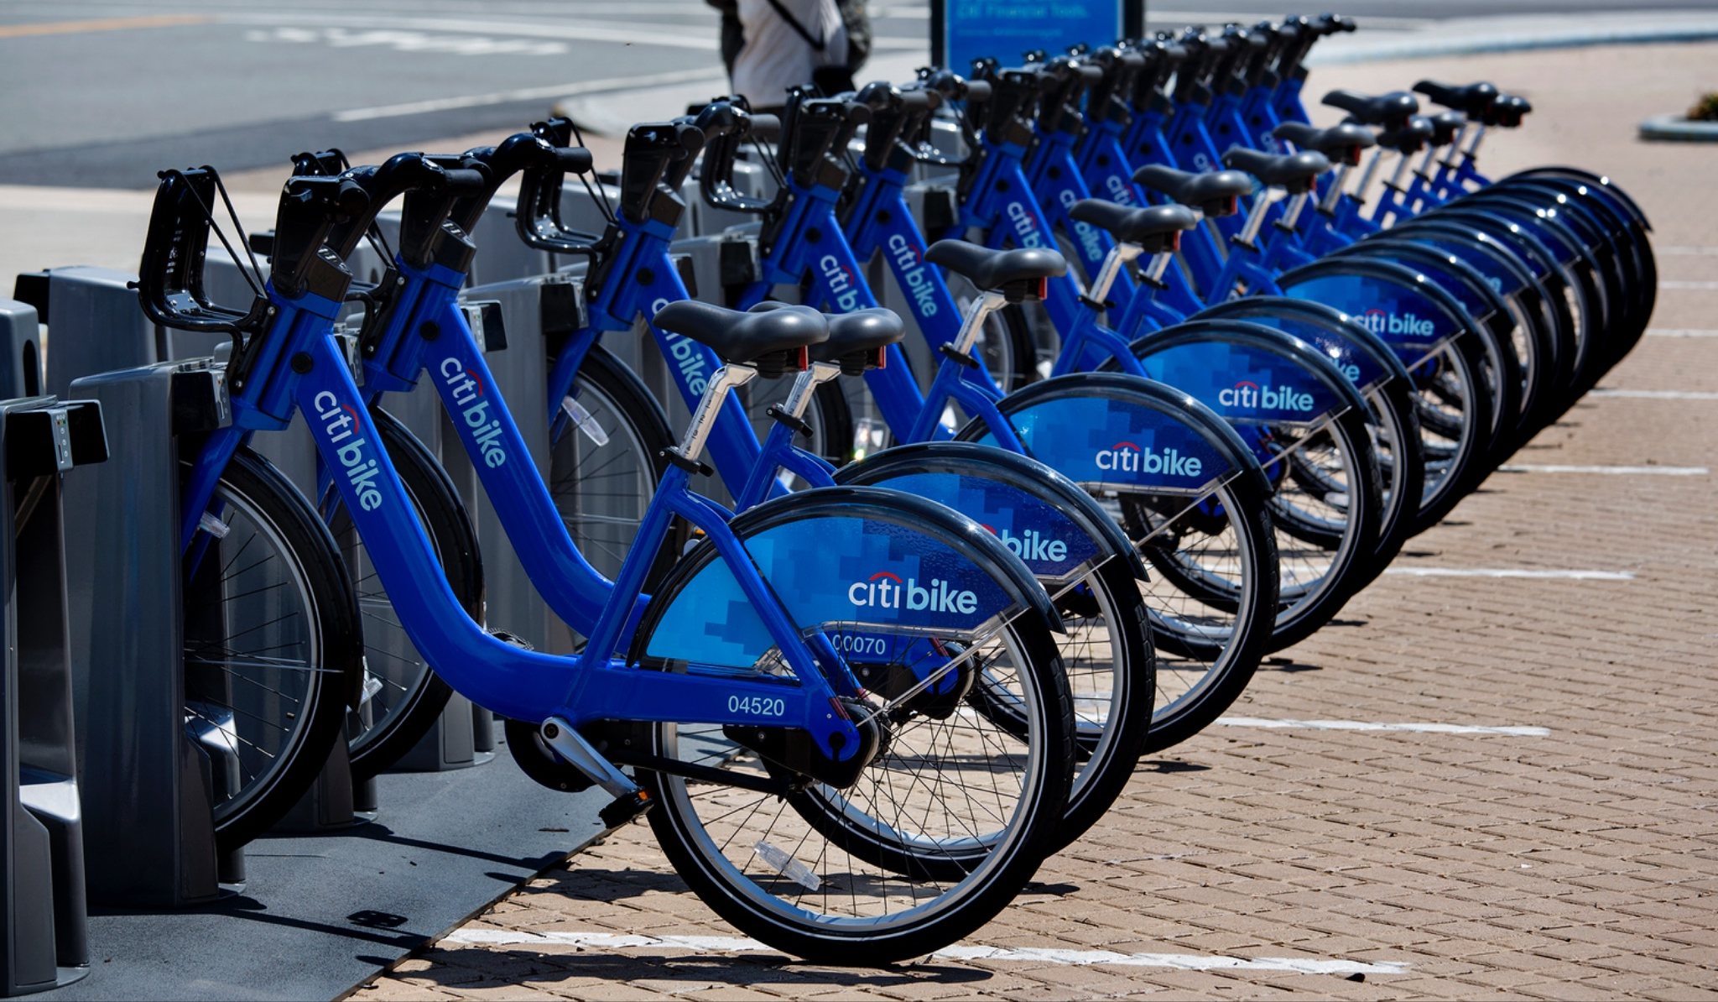

Bike Share Analysis
By Thomas Segal

Slide 2
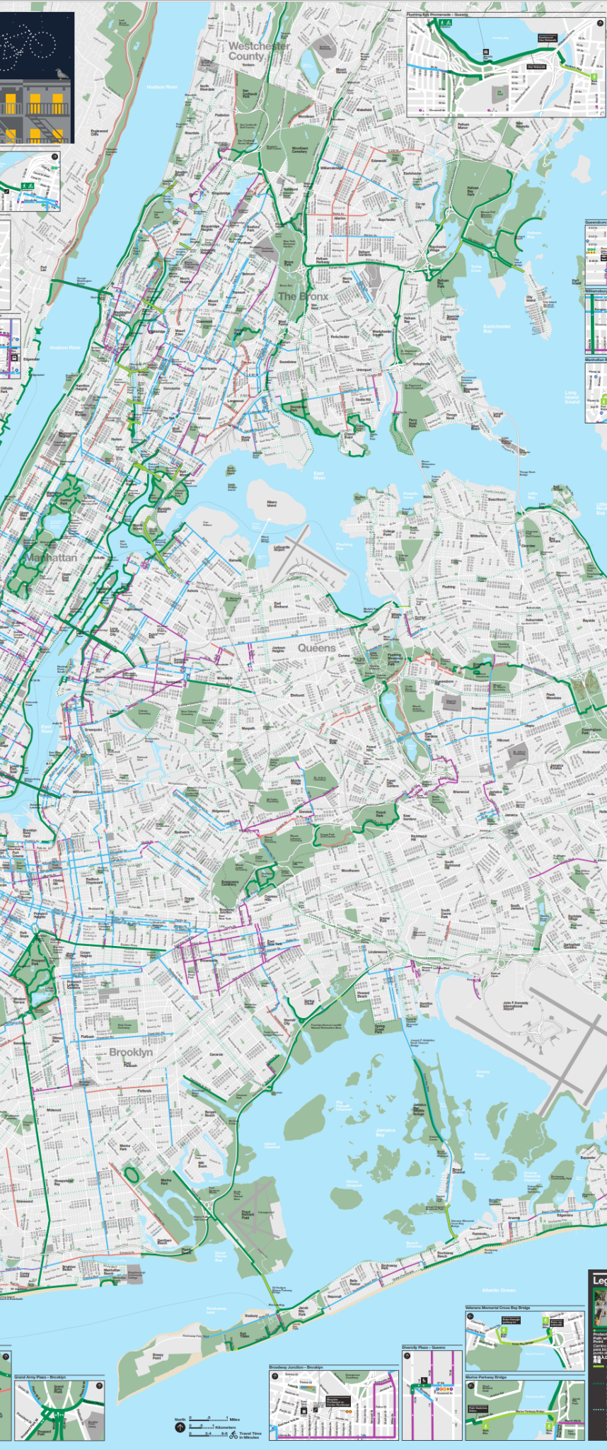
Bike-share demand is driven by commuter patterns and weather with strong weekday peak hours and a significant lift (+15%) after a commuter-focused app feature. Product, ops, and marketing teams should double down on commuters, adjust for weather/seasonality, and expand A/B testing to drive future growth
City-Bike

Slide 3
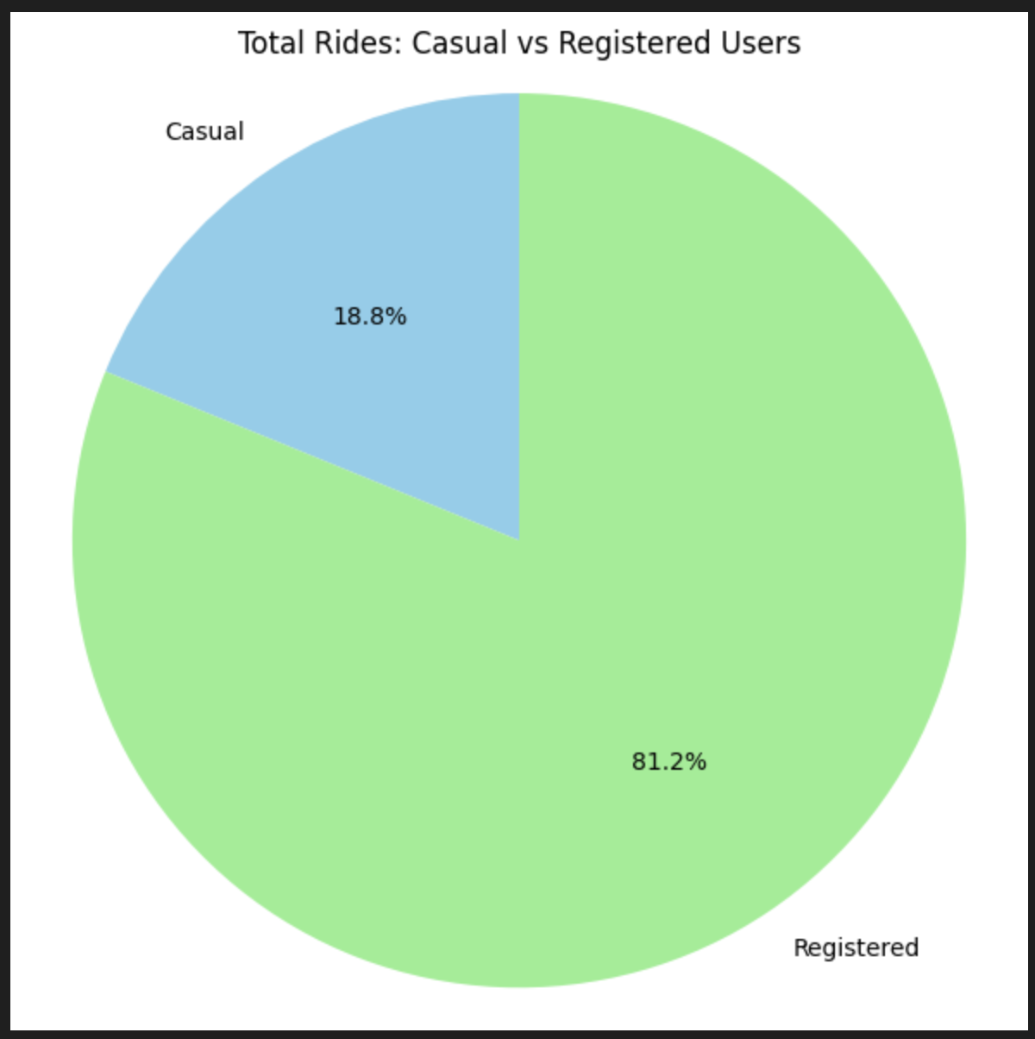
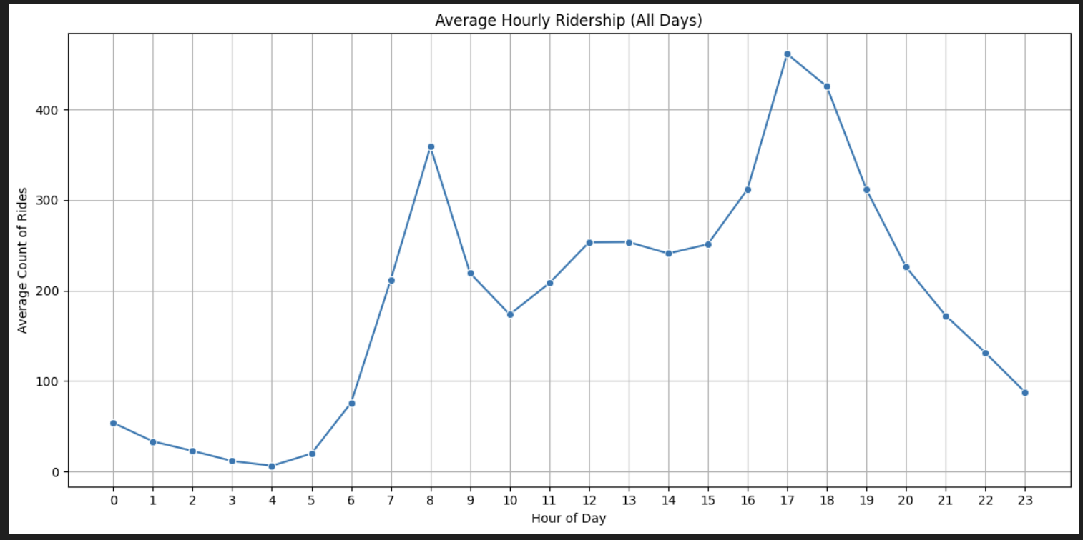
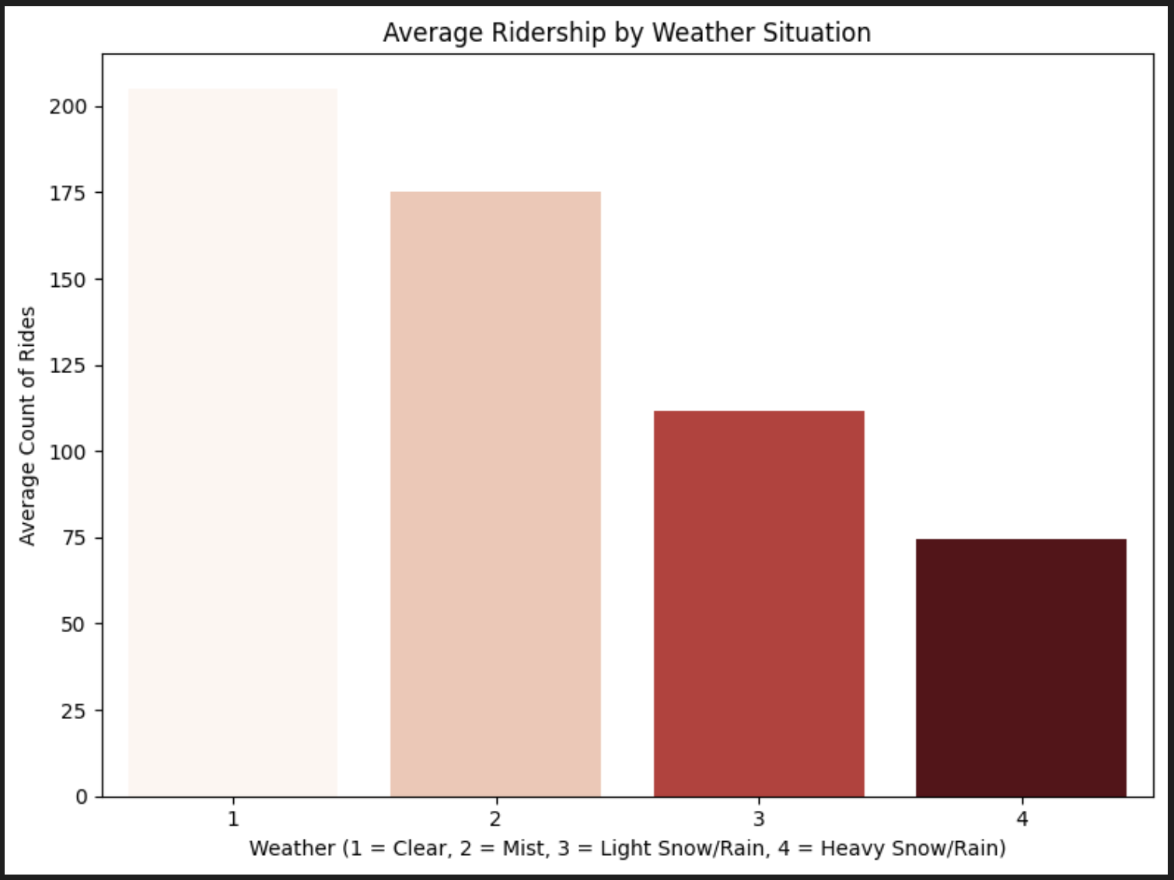
Key findings
Emerging trends
81.2%
Commuters dominate: highest ridership at 8 AM and 5 PM.
Weather & weekday influence demand.
A/B test showed a 15% increase post-feature — a practical success.
Registered users
+15%
Ridership after feature implementation

Slide 4
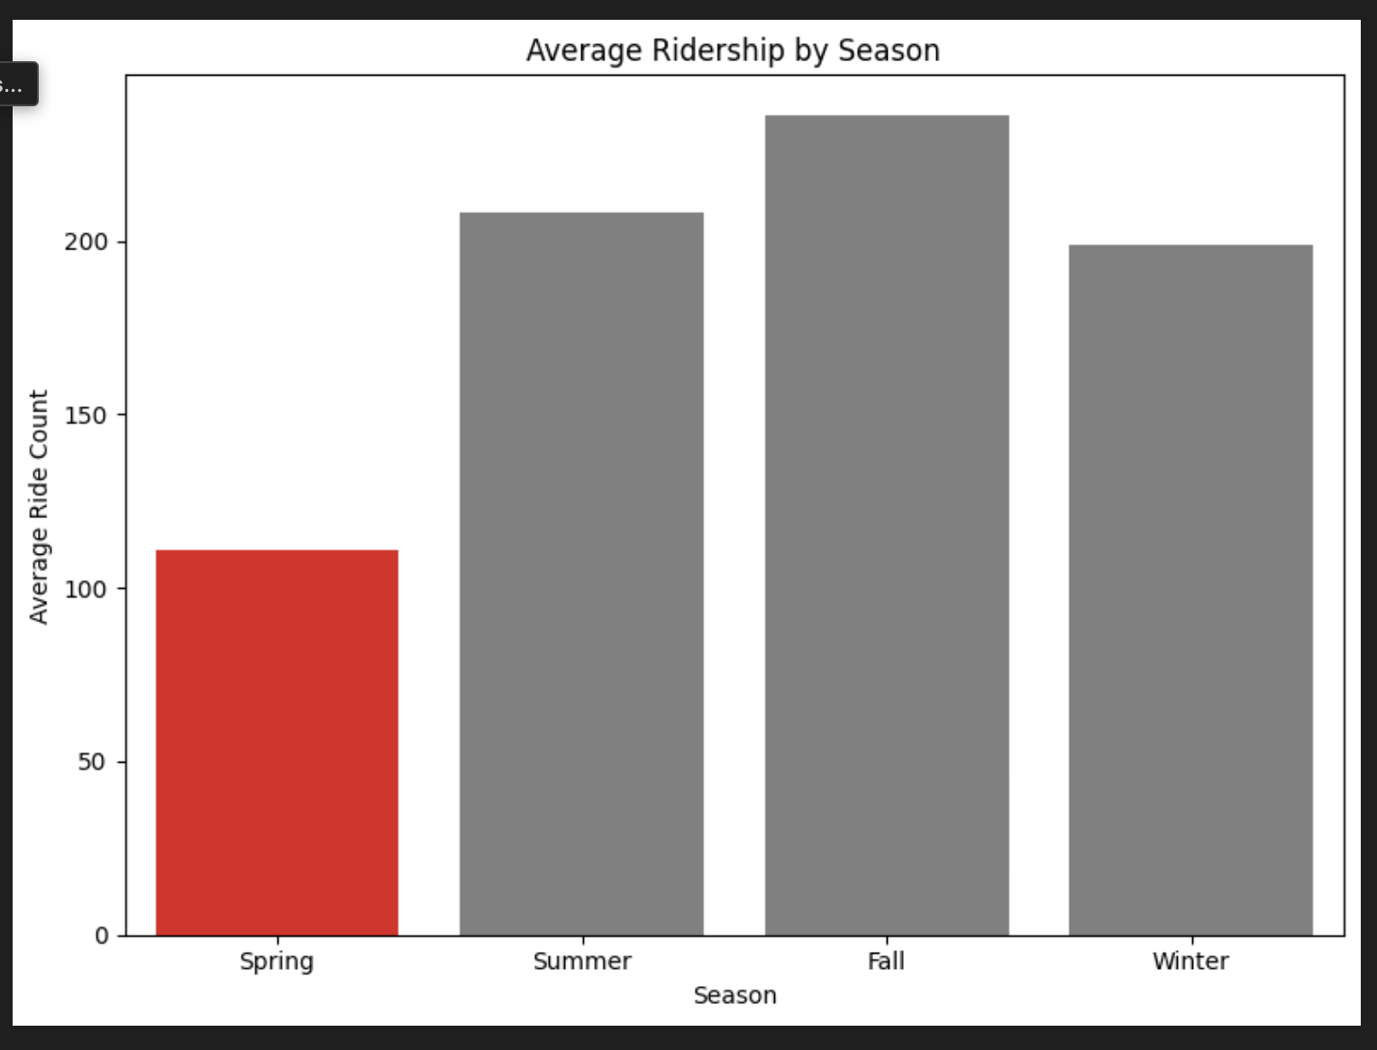
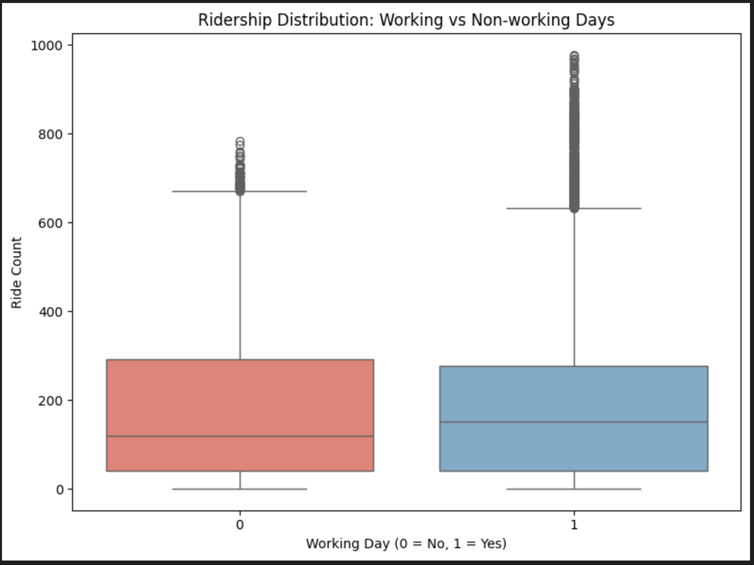
Hypothesis Testing
Test: One-way ANOVA
Post-hoc: TukeyHSD
Decision: Reject the null hypothesis!
Insight: Average hourly rides do significantly differ between at least some seasons. The size of these differences with such a small p-value have clear operational, financial, and strategic implications for pricing, resource allocation, and customer engagement. making it not only statistically significant but practically significant as well.
The appropriate post-hoc approach would be a Tukey's HSD for pairwise comparisons between seasons to determine which specific pairs of seasons differ significantly.
Test: Welch’s t-test
Result: p-value = 0.00004
95% CI: (6.15, 17.45)
Decision: Reject null hypothesis!
Practical Insight: There is a statistically and practically significant difference in hourly ride counts between working and non-working days. On average, working days see 6 to 17 more rides per hour, which can translate to hundreds of additional daily rides.

Slide 5
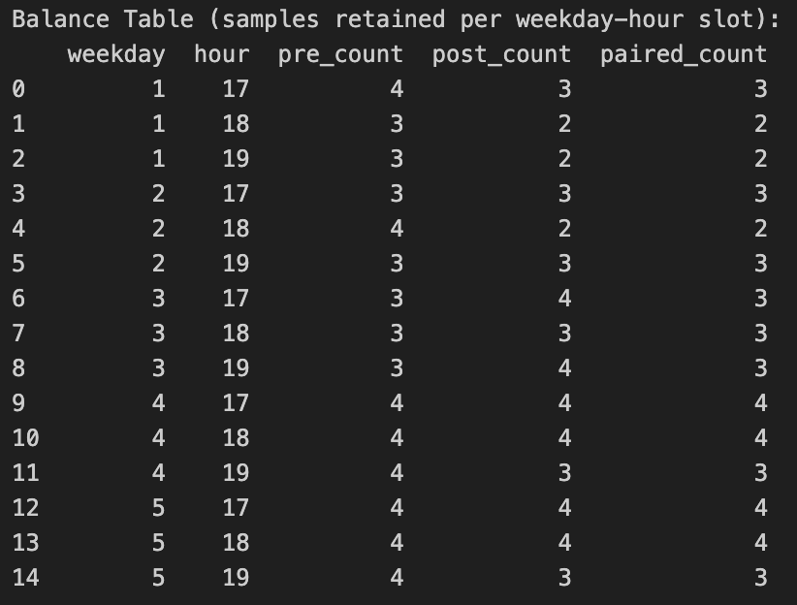
A/B Test — Commuter Hour Ridership
Objective:
Measure the impact of an app feature (launched on 2012-09-01) on weekday evening (17:00–19:00) ridership during good weather.
Statistically and practically significant
(~15% lift). Suggests increased demand likely due to the feature — may warrant operational changes (e.g., staffing, fleet availability).
Eligibility Criteria:
workingday == 1
hr ∈ {17, 18, 19}
weathersit ∈ {1, 2}
hum ≤ 0.70
Windows:
Pre (Group A): 2012-08-04 → 2012-08-31
Post (Group B): 2012-09-01 → 2012-09-28
Test:
Paired t-test
Null: No difference in avg. hourly rides
α = 0.05
Results:
p-value: 0.0006
95% CI: [-63.6, -18.7]
Mean Increase: +41.15 rides/hour
Cohen’s d: 0.30 (small–medium)

Slide 6
Recommendations:
Product Manager
Invest in feature development that supports commuter behavior
Operations Lead
Prioritize commuter peak hours
Marketing Lead
Design seasonal campaigns
A/B test showed a +41.15 rides/hour increase after feature launch
Risks/Ethics:
Avoid over-focusing on peak or registered users → inclusion matters
Dataset is time-limited (2011–2012); seasonal labels may be slightly off
No pricing data → limits business optimization potential
Focus staffing, bike rebalancing, and maintenance during 8 a.m. and 5 p.m. peaks
Create special promotions in underperforming seasons identified via ANOVA results
City-Bike

